Slide 1
TrEES

Slide 2
Binary trees

Slide 3
Binary Trees
A commonly used type of tree is a binary tree
Each node has at most two (bi) children
The “tree” is a conceptual structure
The data can be stored either in
a dynamic linked tree structure, or
in contiguous memory cells (array) according to a set pattern;

Slide 4
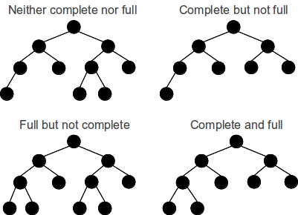
Binary Trees -Types
What is the difference between full and complete binary tree?

Slide 5
Binary Trees -Types
Balanced binary tree: for each node, the difference in height of the right and left sub-trees is no more than one
Completely balanced tree: left and right sub-trees of every node have the same height

Slide 6
Balanced Binary Tree
a
a
b
c
b
c
e
d
e
f
g
d
f
h
i
j
g
h
A balanced binary tree
i
j
An unbalanced binary tree
A binary tree is balanced if every level above the lowest is “complete” (contains 2^{n} nodes)

Slide 7
Properties of binary trees
A complete binary tree of level d is the strictly binary tree (perfect) all of whose leaves are at level d
A complete binary tree of level d has 2^{l} nodes at each level l where 0<=l<=d
Total number of nodes (tn) in a complete binary tree of depth d will be:

Slide 8
Properties of binary trees
For a complete binary tree if number of nodes (tn) are known, then we may find depth of the binary tree
Notes:
A complete binary tree with nodes n has height O(log₂n)

Slide 9
Properties of binary trees
The number L of leaf nodes in a perfect (or complete) binary tree can be found using this formula:
where h is the depth of the tree
The number n of nodes in a perfect (or complete) binary tree can also be found using this formula:
where L is the number of leaf nodes in the tree.

Slide 10
Tree ADT
Objects: any type of objects can be stored in a tree
accessor methods
root() – return the root of the tree
parent(p) – return the parent of a node
children(p) – returns the children of a node
query methods
size() – returns the number of nodes in the tree
isEmpty() - returns true if the tree is empty
elements() – returns all elements
isRoot(p)
other methods
Tree traversal, Node addition/deletion, create/destroy

Slide 11
Binary Trees Storage
Array based implementation
Linked List based implementation

Slide 12
Binary Tree: contiguous storage
Value in root node stored first, followed by left child, then right child
Each successive level in the tree stored left to right;
Children of any given node n is stored in cells 2n and 2n + 1
(If array index starts at 1)
What if it starts at 0?
Storage allocated for full tree, even if many nodes empty
What size array is required for a tree of depth h?
Notes:
What size array is required for a tree of depth h?
we need array of 2^{h+1}-1 cells

Slide 13
A complete (almost) binary tree in array
A
B
C
[1]
[2]
[3]
[4]
[5]
[6]
[7]
[8]
[9]
A
B
C
D
E
F
G
H
I
D
E
F
G
H
I

Slide 14
A binary tree (incomplete) in array
[1]
[2]
[3]
[4]
[5]
[6]
[7]
[8]
[9]
.
[16]
A
B
--
C
--
--
--
D
--
.
E
A
B
C
D
E

Slide 15
Binary Tree: as a linked structure
Each node in the tree consists of:
The data, or value contained in the element
A left child
A right child

Slide 16
class Node
{
int value;
Node LeftChild,RightChild;
} /***Operations*********/
/************************/

Slide 17
a
b
c
d
e
f
g
h
i
j
k
l

Slide 18
Traversal of Binary Trees
Pass through all nodes of tree
Inorder (symmetric traversal)
Preorder
Postorder

Slide 19
Trees Traversal
Inorder
(Left) Root (Right)
Preorder
Root (Left) (Right)
Postorder
(Left) (Right) Root
Root
Left
Right

Slide 20
Inorder Traversal
+
Left Root Right manner
Left + Right
[Left*Right]+[Left+Right]
(A*B)+[(Left*Right)+E)
(A*B)+[(C*D)+E]
*
+
A
B
*
E
C
D
(A*B)+(C*D+E)

Slide 21
Preorder Traversal
+
Root Left Right manner
+ Left Right
+ [*Left Right] [+Left Right]
+(*AB) [+ *Left Right E]
+*AB + *C D E
*
+
A
B
*
E
C
D

Slide 22
Postorder Traversal
+
Left Right Root manner
Left Right +
[Left Right *] [Left Right+] +
(AB*) [Left Right * E + ]+
(AB*) [C D * E + ]+
AB* C D * E + +
*
+
A
B
*
E
C
D

Slide 23

Expression tress
What is an algebraic expression?
Each algebraic expressions has an inherent tree-like structure
Example: a/b + (c-d) * e can be represented as

Slide 24
Expression Trees
The terminal nodes (leaves) of an expression tree are the variables or constants in the expression (a, b, c, d, and e).
The non-terminal nodes of an expression tree are the operators (+, -,*, and /).
No parentheses but the tree representation has captured the intent of the parentheses

Slide 25
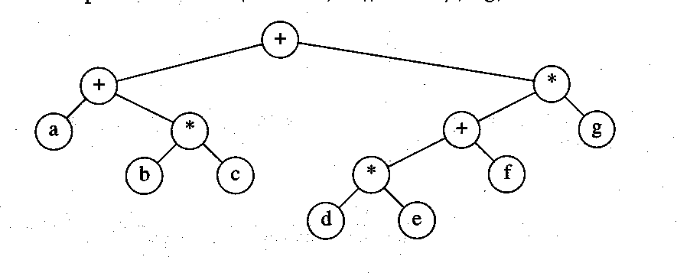
Expression Trees
(a+(b*c)) +((d*e+f)*g)

Slide 26
Algorithm: convert postfix into expression tree
Read one symbol at a time from the expression.
If the symbol is an operand, one-node tree is created and a node is pushed onto a Stack
If the symbol is an operator, the nodes are popped to two trees T1 and T2 from the stack and a new tree whose root is the operator and whose left and right children refer to T2 and T1 respectively is formed . A node reference to this new tree is then pushed to the Stack.

Slide 27
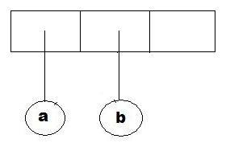
Algorithm: convert postfix into expression tree
Example: a b + c d e + * *

Slide 28
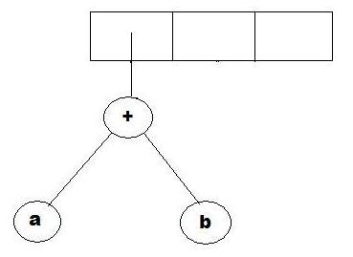
Algorithm: convert postfix into expression tree
Example: a b + c d e + * *

Slide 29
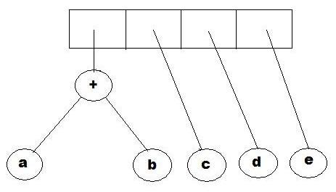
Algorithm: convert postfix into expression tree
Example: a b + c d e + * *

Slide 30
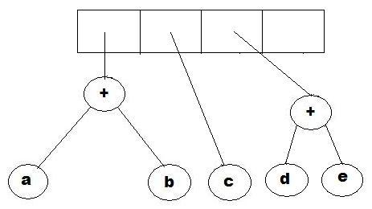
Algorithm: convert postfix into expression tree
Example: a b + c d e + * *

Slide 31
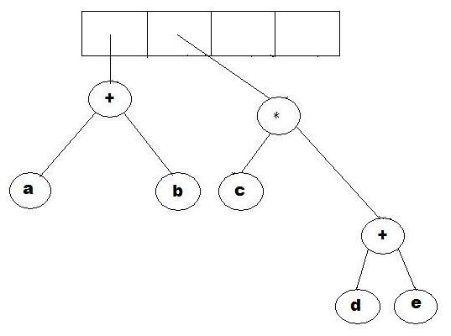
Algorithm: convert postfix into expression tree
Example: a b + c d e + * *

Slide 32
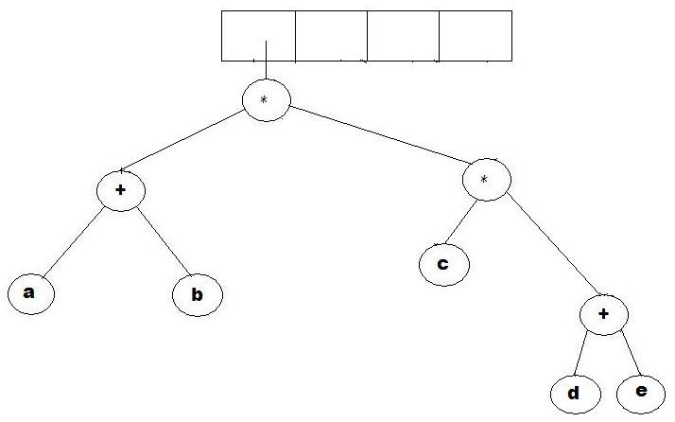
Algorithm: convert postfix into expression tree
Example: a b + c d e + * *

Slide 33
Why use expression trees?
Perhaps the simplest thing to do is to print the expression represented by the tree.
But it would be better if we can somehow evaluate the tree to get results.
Any suggestions on how this can be done?

Slide 34
How to evaluate an expression tree?
To evaluate a binary expression tree, we just need to do a post-order traversal of the tree, and ask each node to evaluate itself.
An operand node evaluates itself by just returning its value. An operator node has to apply the operator for that node to the result of evaluating its left sub-tree and its right sub-tree.

Slide 35
How to evaluate an expression tree?
Example: a b + c d e + * *
1 2 + 3 4 5 + * *

